Slide 1
UCaaS Powered by Webex
Quick User Guide

Slide 2
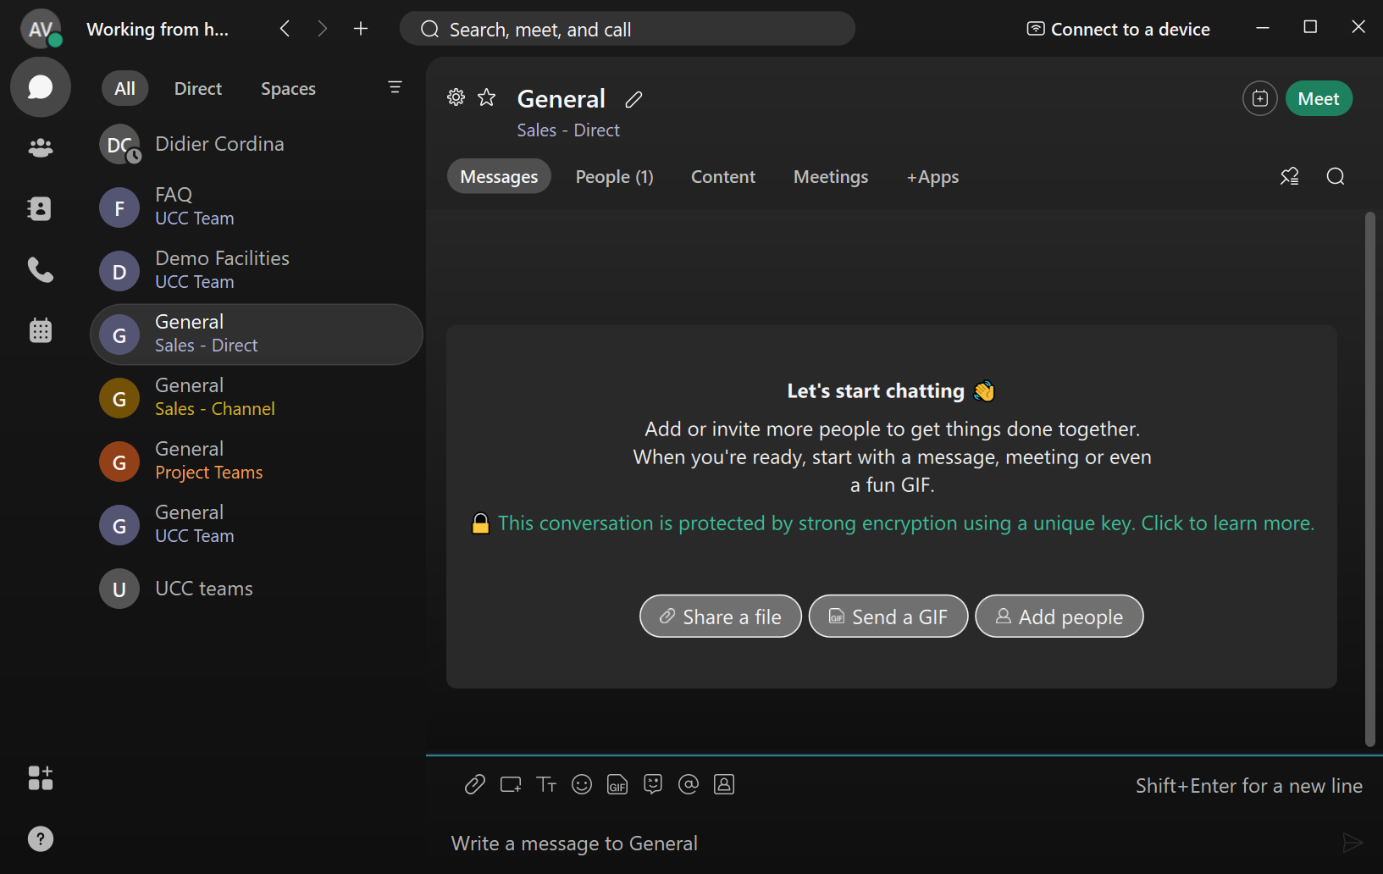
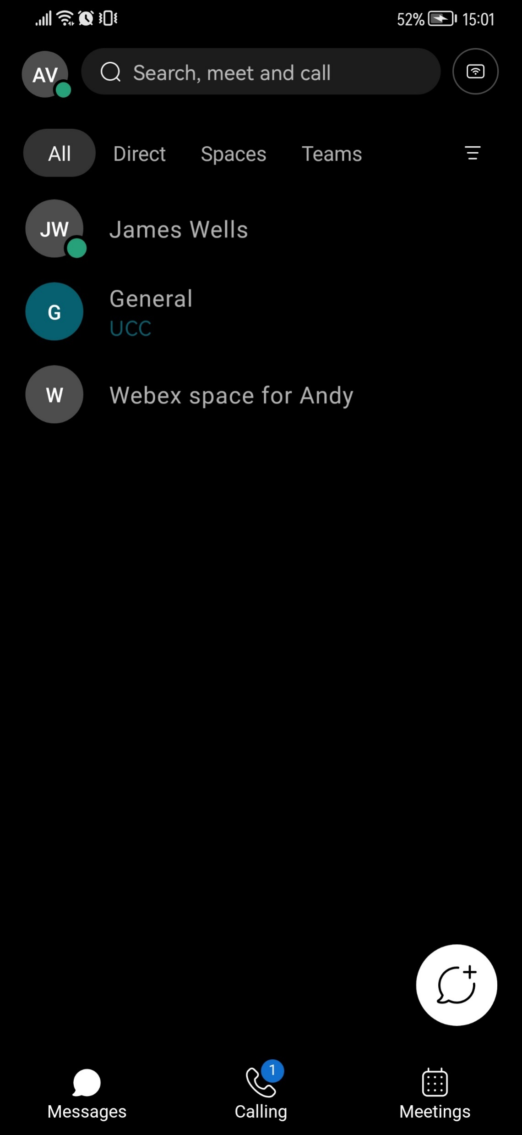
Simple, all-in-one solution
Advanced calling, messaging, and meetings capabilities all in one elegant app. Simple management without complexity of multiple solutions and one supplier for all your communication and collaboration needs.
Productive and professional
Leverage a modern collaboration app expected by today’s workers to retain employees, that also helps improve client responsiveness to drive customer satisfaction.
Secure and reliable
Seamlessly collaborate with internal and external participants with peace of mind and a consistent, great experience, while end-to-end enterprise-grade encryption keeps your proprietary data safe.
Flexible and predictable
Our SaaS model, per-user, per-month, lets you scale users up as needed. Or, mix packages and tailor your solution to the unique needs of everyone in your organisation.
Let’s go, click on either the Desktop or Mobile client.
You can use our logo in the top left to return to this page at any time.

Slide 3
Overview
Current Status / Profile New Action (Message, Space, Call) Search Devices
Status / Presence
Messaging
Teams
Contacts
Calling
Meetings
App Marketplace
Help
Webex offers an intuitive, easy-to-use interface for users to collaborate from anywhere.
Drive productivity in your teams, and accelerate access to experts with feature-rich and easy-to-use collaboration tools
Enhance business outcomes and increase employee satisfaction with better meeting experiences
Calling, meetings, messaging, all in one app with your content and information in one place
Keep work moving in meeting rooms with fully integrated Cisco Webex devices
Keep your important information safe and secure with advanced security and compliance
Let’s go, click on any of the features. You can use our logo in the top left to return to this page at any time.

Slide 4
Availability / Settings
Availability allows you to set yourself to DND for a specified amount of time
Use the Status to set pre-defined or custom messages to present to your colleagues
Edit your Profile to change your Display Name, Cover Image and Profile Picture
Use Settings to change your Call Handling, default audio / video options, notifications, themes and more
Help offers a powerful knowledge base and health check tool to self diagnose.
Scan the QR code with your mobile to download the Webex Mobile App

Slide 5
Quick Action
Simply click the + icon to create new activities in seconds.
You can:
Send direct messages to colleagues
Create ad-hoc spaces to bring new colleagues together to collaborate
Make a new call
Add a new contact
Schedule a meeting
Start a new meeting

Slide 6
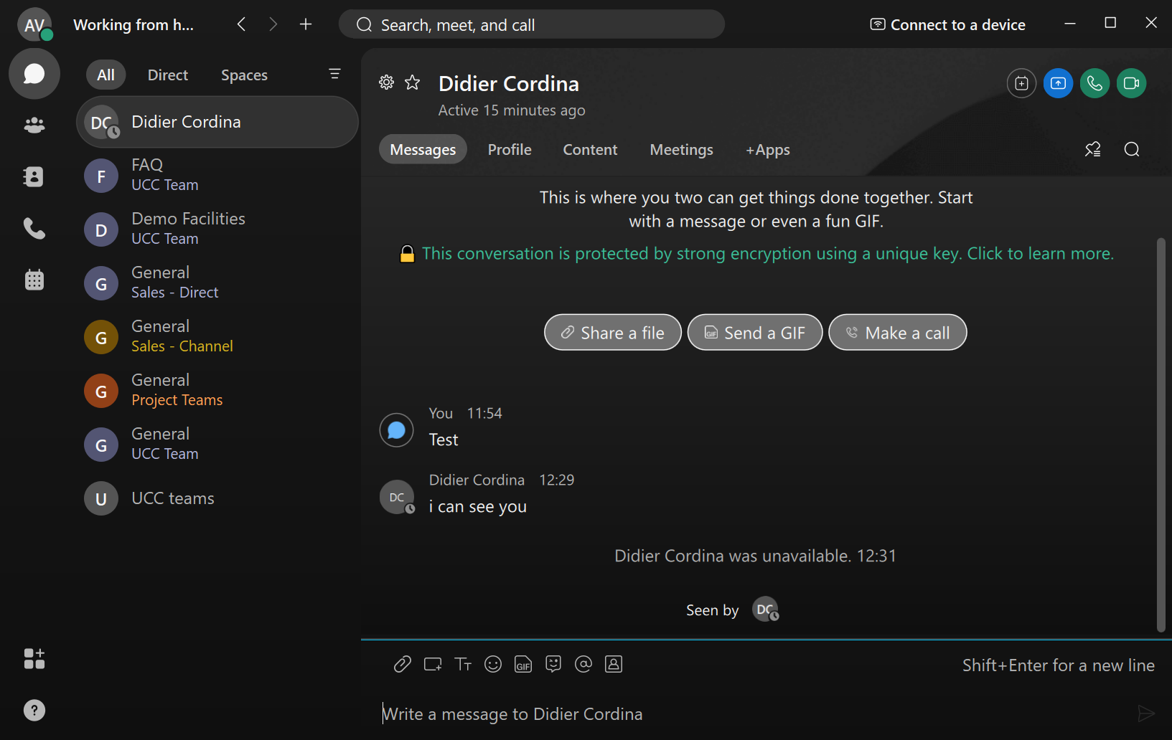
Chat
Filter what messages you want to see: Unread, @ Mentions etc
Click between All, Direct or Space conversations
Navigate through your full list of Spaces
Users can message each other one to one or in spaces (persistent group chat)
Better inter-departmental collaboration to complete projects and tasks
Highlight features:
Instant Messaging
Share Files, Whiteboards, Links and store content from Meetings
Integrate with 3rd Party Apps from the Webex Marketplace to boost productivity (SalesForce, SNOW etc)
Quick buttons allow you to share a screen shot, files, GIFs and much more for a better experience
Easily reply, forward and react to messages

Slide 7
Chat
Filters allows you to quickly view the specific types of Spaces you are after. You can filter on:
New notifications for mentions, content shared, meetings started etc
Any unread messages
Your favourite Spaces
Any hidden messages you may have archived
Specific @ Mentions of yourself of all members
You can also flag Spaces to make them easier to find in the future

Slide 8
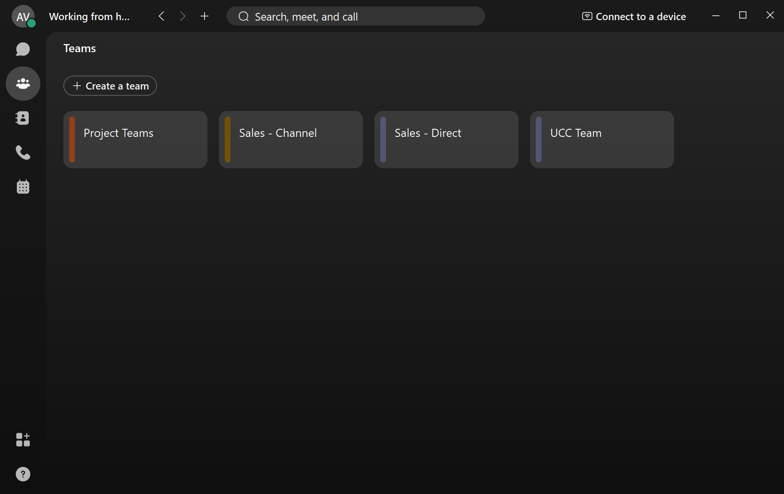
Team Spaces
Teams create channels for departments to collaborate through a number of Spaces
You may be part of a single, or multiple Teams depending on your role within the organization
Teams are primarily used for departments for long term collaboration, whilst individual Spaces are for ad-hoc projects
Create a new team
Click to enter your Team space

Slide 9
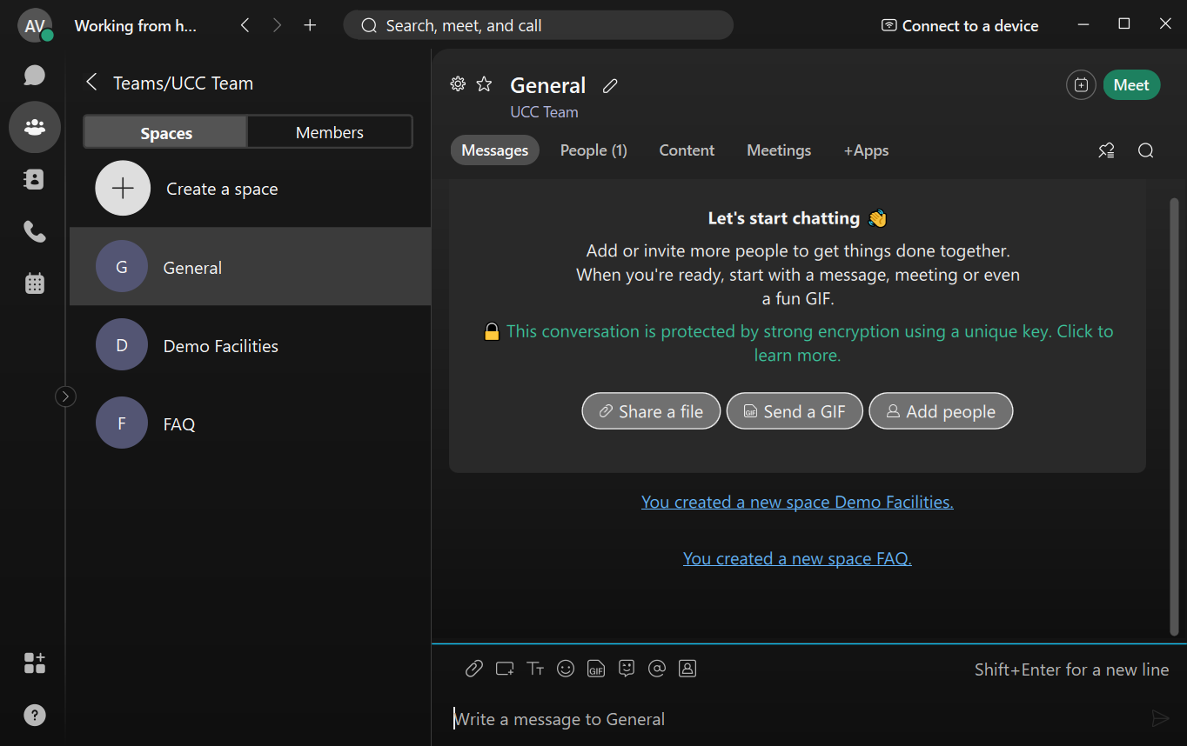
Team Spaces
Teams create Channels for departments to collaborate through a number of Spaces.
Spaces are persistent, making it the perfect place to collaborate and share content / knowledge with your colleagues
View Team Members
Navigate through your full list of Spaces within the Team Channel

Slide 10
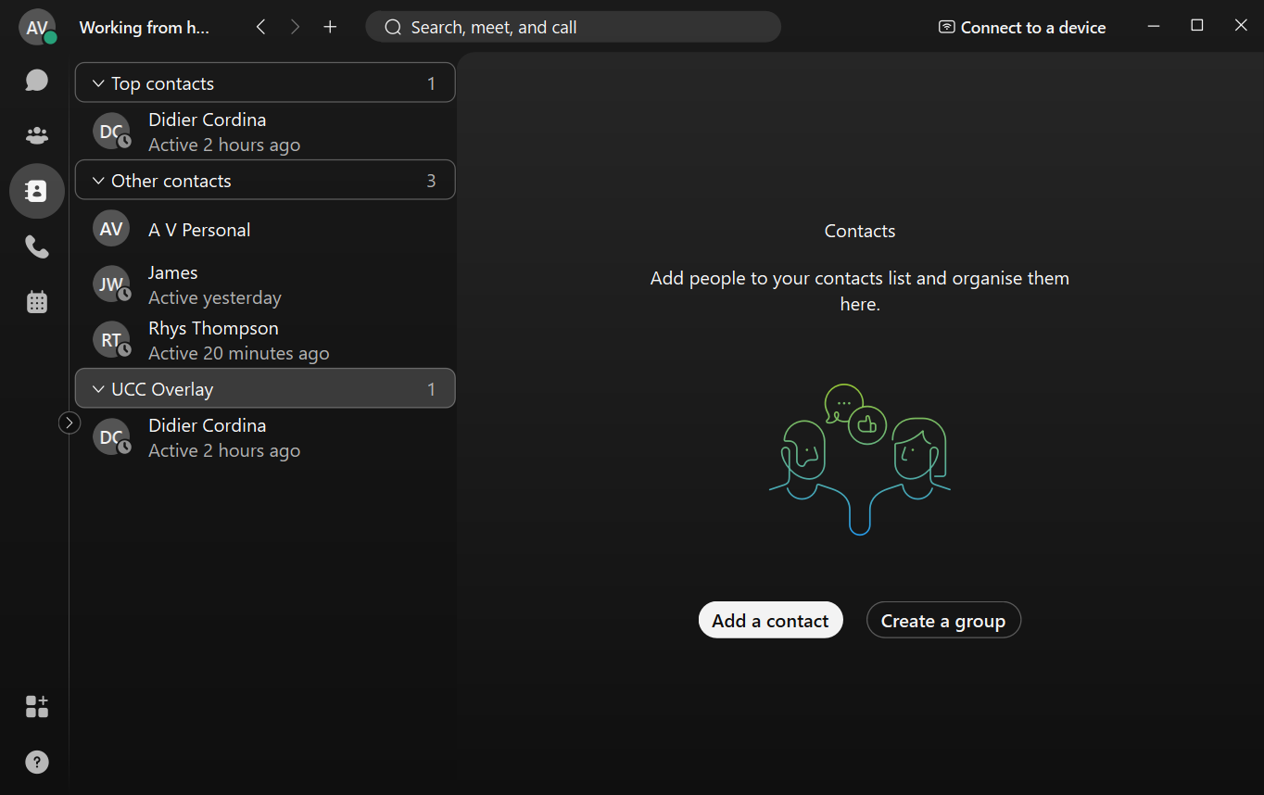
Contacts
Pin your favourites to the top
Custom Groups to sort your contact
Contacts can be used to store both internal and external contacts.
Pin your common callers to the top in “Top Contacts”
Create contact Groups to sort between departments, teams, external suppliers etc
View presence and status messages for internal and other external Webex users
Simply hover over a contact and click on Audio or Video call to speak with them

Slide 11
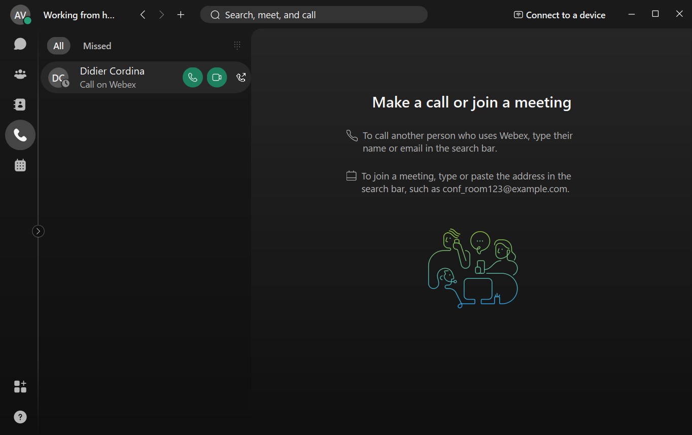
Calling
Easily start an Audio or Video Call using the green quick buttons for your colleagues
Alternatively, you can expand their contact card and click on their DDI or Mobile
For external contacts, simply search your contacts or dial a new number using the dial pad
When you’re in a call, you still have your core functions to place calls on hold, transfer, park and conference other people in.
To accept a call, simply click Answer or Decline on the toaster pop up
Full list of Missed, Placed or Received Call

Slide 12
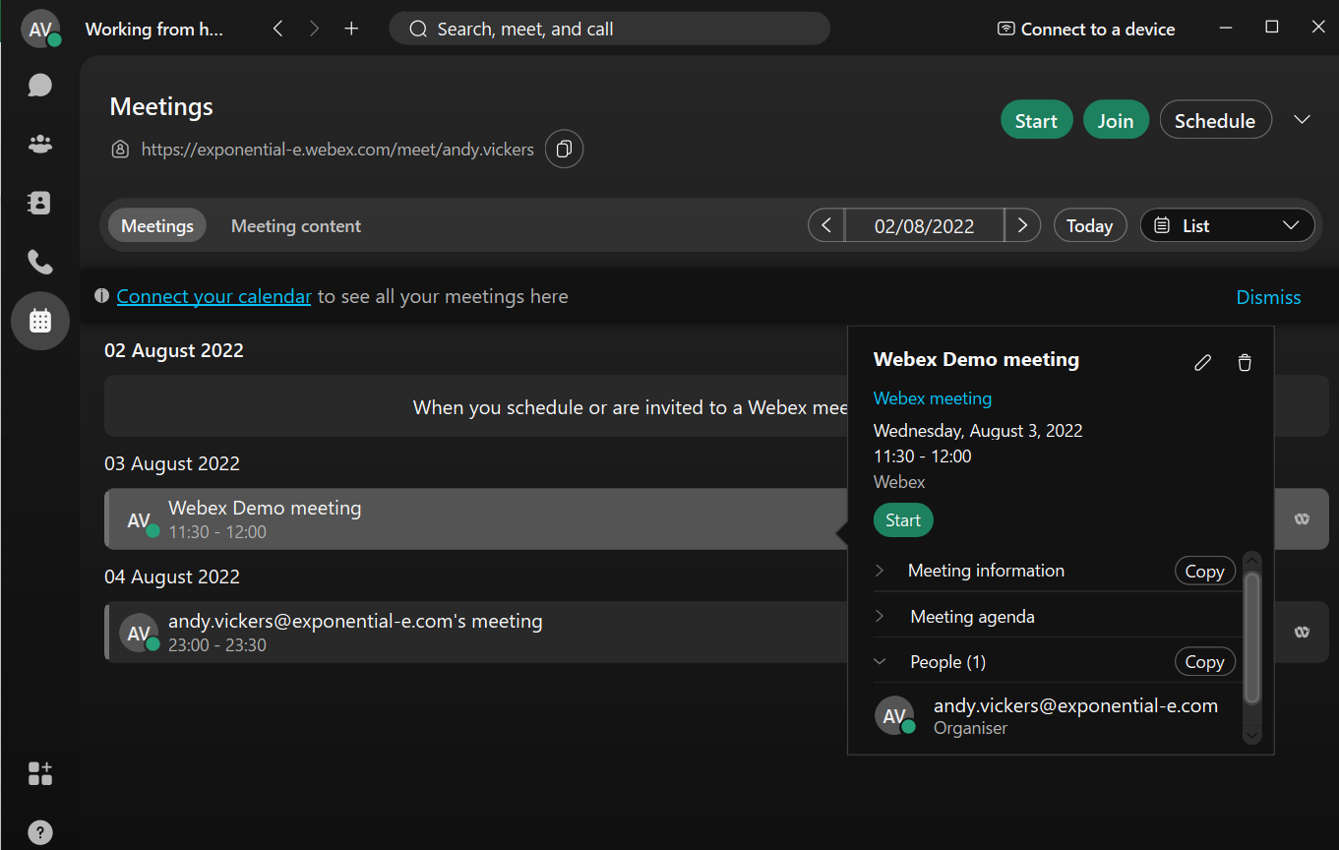
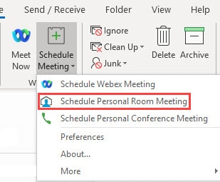
Meetings
Schedule Meetings
Meetings allows you to start an Ad-Hoc meeting, join another meeting or schedule a new meeting
Invite Colleagues, Contacts or external parties
Connect your Outlook calendar to provide seamless visibility when scheduling a new meeting
Click on a Scheduled meeting to view further details or join the meeting
You can also install the Outlook Plug-In to schedule meetings directly from Outlook
View your upcoming meetings

Slide 13
Mobile - Chat
Status / Presence
Navigation Bar
The Cisco Webex application is available on both Android and iOS devices, giving you the flexibility to stay connected on the move.
Requirements
iPhone and iPad—iOS 12.0 and later, and iPadOS 13.1 and later
Android smartphones—Nougat 7.0 and later (2 GB of RAM required)

Slide 14
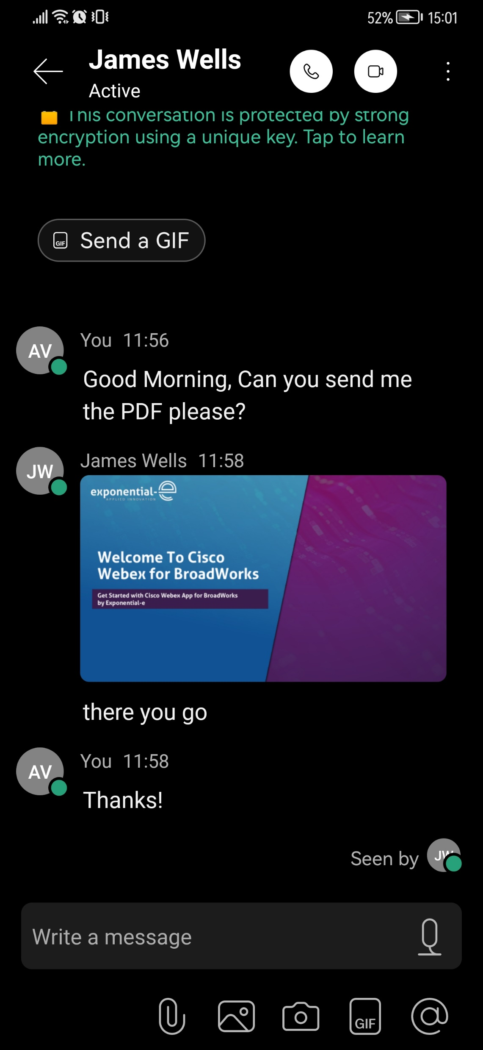
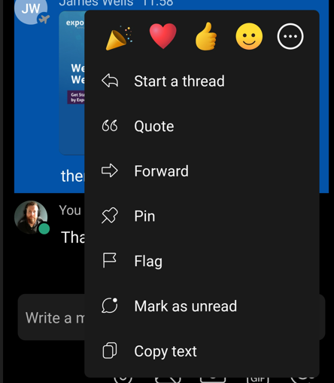
Click the 3-dots to view content, pinned messages and more
Mobile - Chat
Audio or Video Call
Chat Window with access to reactions by pressing and holding with your finger
Share files, picture or images from your camera
Stay connected on the go with full access to your Direct messaging and Space collaboration.

Slide 15
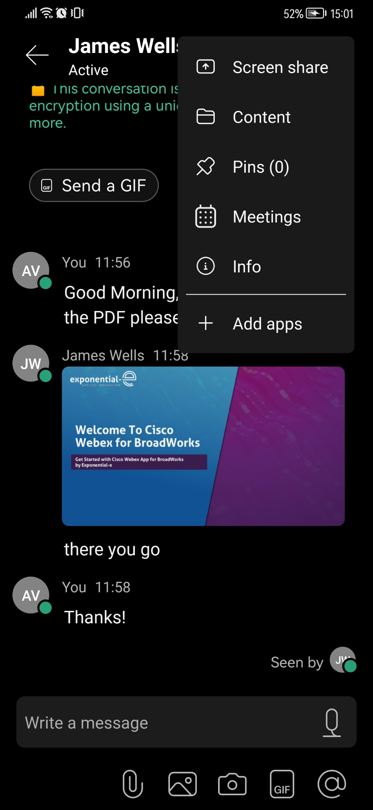
Mobile – Chat
You will have full access to all historic content in the chat.
You also have the ability to manage scheduled meetings, pinned messages and add 3rd party chat bots (SalesForce etc) to keep you informed on the move.

Slide 16
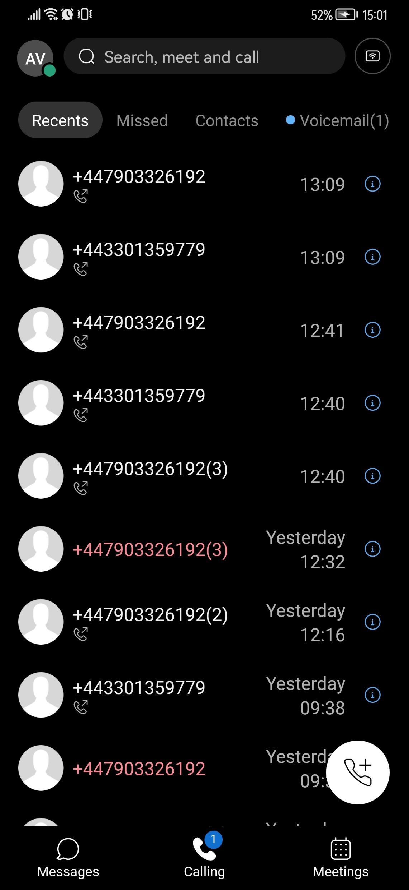
Mobile - Calling
Visual Voicemail & Contacts
Click to show the dial pad for a new call
Filter between Recent and Missed Calls
Navigation Bar
Your call log is synchronised between your devices, whether it’s a mobile app, desktop client or physical desk phone.
You will also have access to your contacts and visual voicemail across these devices.
You are able to view your local device contacts. You can also navigate to your local contact list on your mobile, then click call from Webex.

Slide 17
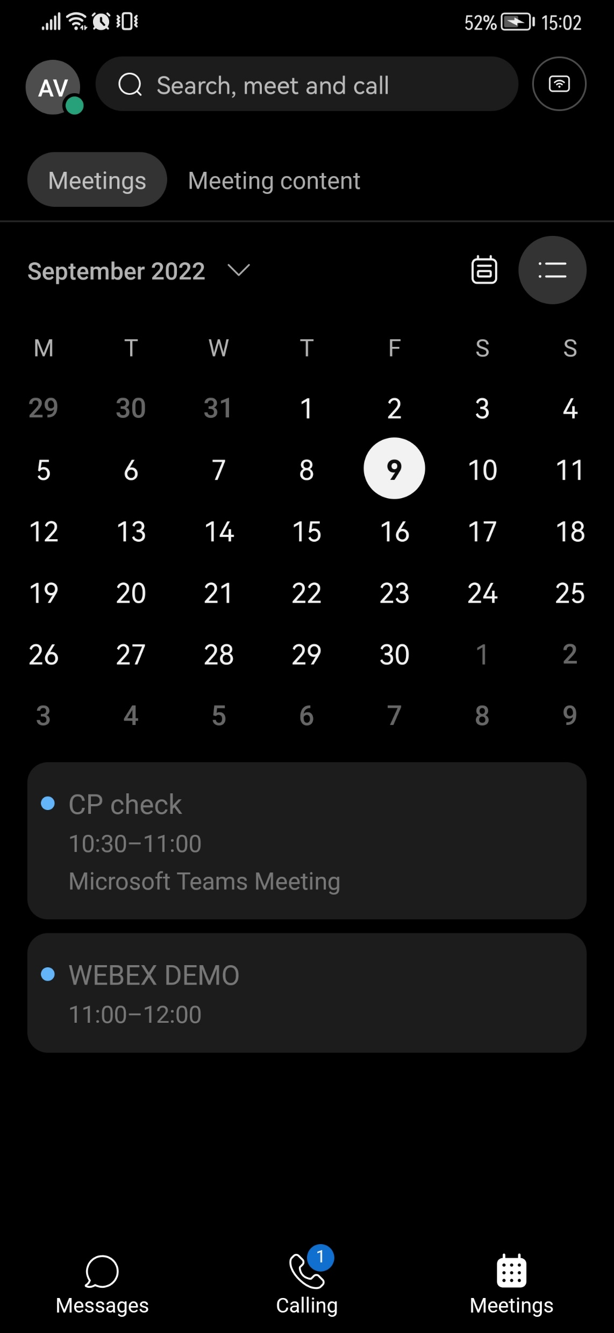
Mobile - Meetings
Stay organized by synchronising your Webex and Outlook calendar in one place.
You will receive alerts and prompts prior to meetings and join them from your mobile.

