Slide 1
EXPO.e SASE Solution
Be Unstoppable with EXPO.e

Slide 2
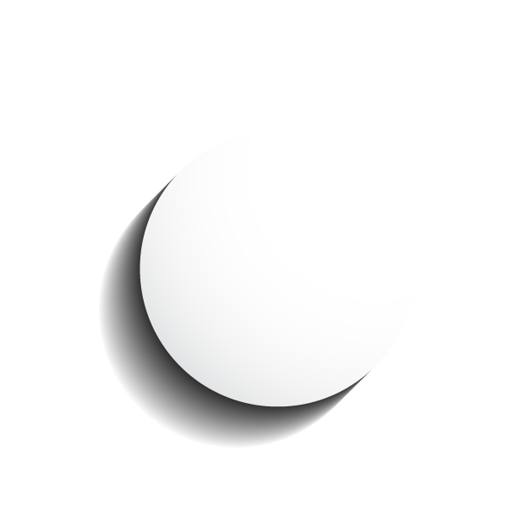

Why SASE for you
Data Protection
Protects data everywhere it goes, inside and outside the organisation, including within public clouds and cloud apps
Cost Savings
Eliminates CapEx for on-premise infrastructure and provides lower OpEx as a SaaS model
Reduces Complexity
Enables organisations to shift IT staff from managing multiple appliances to focusing on delivering policy based security services, with unified policy enforcement
Increased Performance
Enhances and accelerates access to internet resources via a global network infrastructure optimised for low latency, high capacity and high availability
Threat Protection
Stops cloud and web attacks such as cloud phishing, malware, ransomware and malicious insiders
Notes:
.

Slide 3
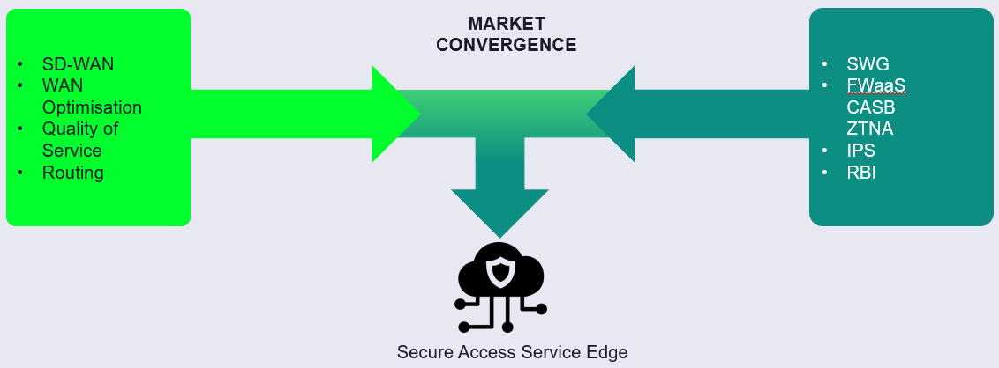


What is SASE
“Secure Access Service Edge (SASE) delivers converged network and security as a service capabilities, including
SD-WAN, SWG, CASB, NGFW and zero trust network access (ZTNA).
SASE supports branch office, remote worker and on-premises secure access use cases. SASE is primarily delivered as a service and enables zero trust access based on the identity of the device or entity, combined with real-time context and security and compliance policies.”

Slide 4
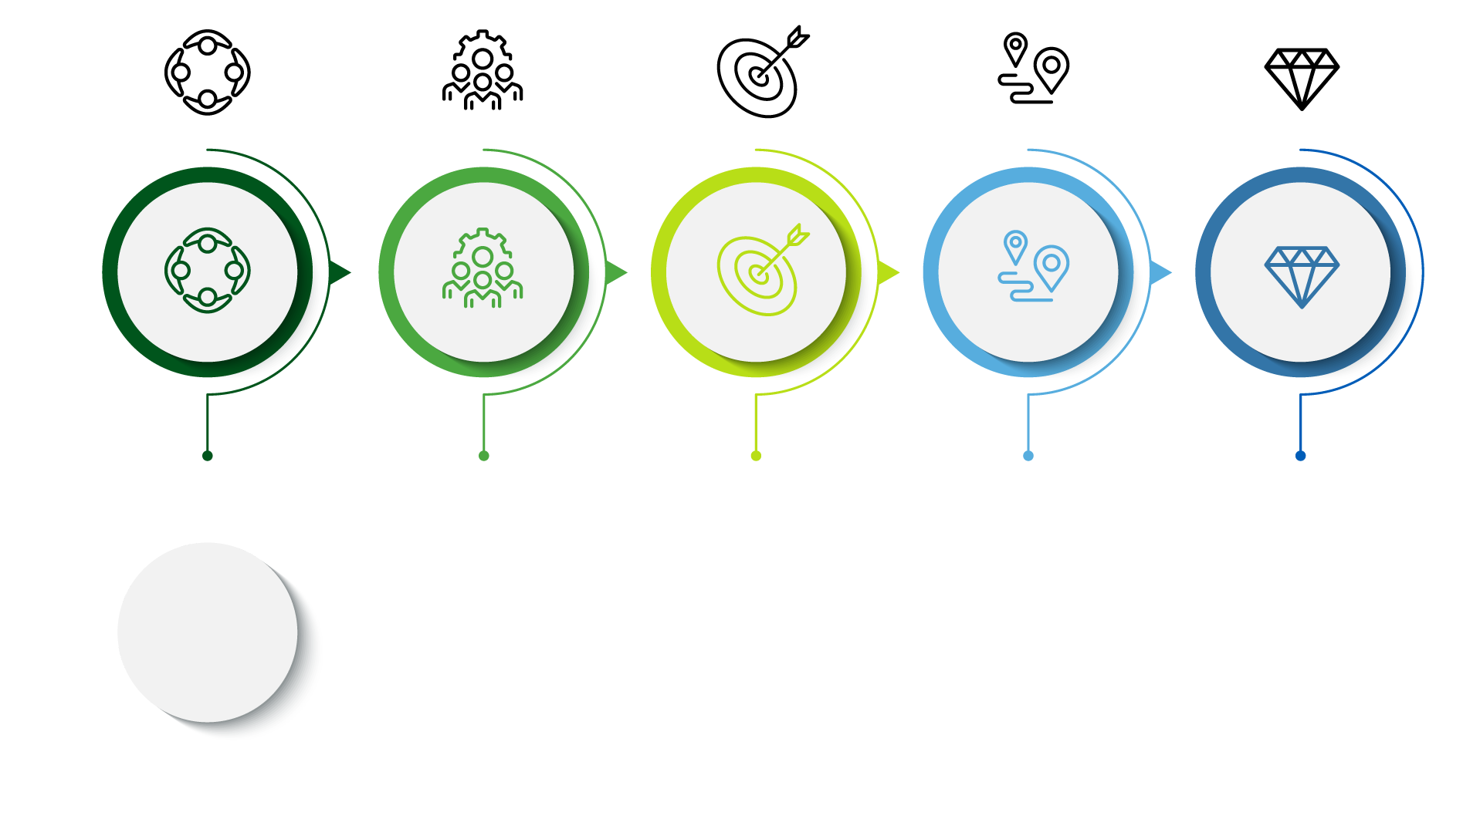
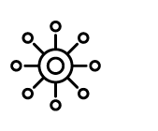
Are you facing any of these challenges?
SASE could be the answer
You require a connectivity solution that is designed for cloud-based adoption, which your existing solution WAN architecture may not support?
You have a national, global, multi-site or dispersed workforce where Zero Trust is a priority?
You have an increasing need to find a more cost
effective solution that allows you to
optimise your network resources.
You need a Cyber Security Solution that supports the flexibility to expand both nationally and internationally.
You need a solution that will protect both office and remote users when accessing
resources in the private cloud, public cloud and on the internet.

Slide 5
The Solution & Components
Remote Access
Sites
Client, clientless access Priced per user
Global or Regional Priced per MBPS
Our Secure Access Service Edge (SASE) solution converges both SD-WAN and Security Service Edge (SSE) to offer the most complete single vendor SASE Solution. Providing a cloud-based solution to optimise and secure applications and access for all users, no matter where they are based.
Simple OpEx charge model without the need for upfront cost, allowing flexibility without the need to get larger one-off budgets approved.
Full SASE
Advanced
Security Services
NGAM, IPS, CASB etc
Priced per total BW and users
Hardware
Sockets, Rackmount kits
Priced per quantity
Managed Services
End-to-end solution fully managed by a 24x7 service desk

Slide 6
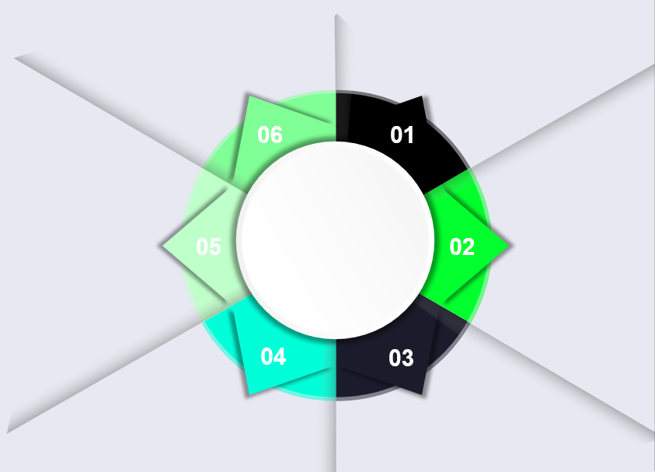
Features & Benefits
Optimize and secure global
mobile users access to
applications on prem and in the
cloud
Cuts MPLS connectivity costs
by augmenting or replacing MPLS with affordable, global SD-WAN
Provides secure Internet
access everywhere without
deploying branch security
appliances
Features
& Benefits
Success
Improves performance
between global locations,
including China, with global private backbone
Optimally connects cloud
datacenters into the WAN with a few clicks
Eliminates branch appliances
with converged cloud-based network security

