Slide 1
[Partner Name]
Be Unstoppable with EXPO.e

Slide 2
Main title slide – Option 2 Background can be Partner branded
[Partner Name]
Be Unstoppable with EXPO.e

Slide 3
Notes:
https://www.youtube.com/watch?v=Vd2vyTZgs94

Slide 4
Our History & Commitment
A Trusted Pair of Hands

Slide 5
Background History
Founded in 2002 as an Ethernet-Only Carrier / Services Provider - Bootstrapper with £400K start-up capital
Organic growth to 2020 Revenues £142m EBITDA £38.5m
Feb 2020 acquired Vysiion - an Engineering projects / installations / CNI / Data Centre & Cybersecurity management company
Sept 2021 acquired Xpertex - Intelligence Services Cybersecurity company
Combined Group 2022 / 23 Revenues £206m; EBITDA £81m
With our commitment to customer service excellence, we invest 95% of our EBITDA back into people, technology and R&D
Today, we have 3,000 clients, 820 employees & operating to management standards with 9 ISO accreditations - recognised as a World-Class IT Service Provider by BSI
And an exceptionally high ‘LIVE REAL-TIME NPS’ score = 78 (Sept 2023) which is over four times higher than the industry average
For 21 years, we built a reputation for designing, delivering and supporting bespoke and complex Network / Cloud / IT / UCC projects to deliver customer outcomes
We have invested £120m building a homogenous Layer 2 Ethernet network with reach throughout UK & internationally, with further investment in our Cloud architecture and Microsoft Teams infrastructure. We call this our ‘non-stop compute platform’
‘We treat your business as if it were our business’ assuring we deliver our clients ‘Peace of Mind-as-a-Service’ backed by full stack SLA’s

Slide 6
The Exponential-e group has over 65 years of experience, credentials and capabilities in delivering critical infrastructure to both the public and private sectors.
The combined skills and expertise of the 3 companies now make ‘military-grade’ solutions more accessible and available to our partners underpinning critical partners customer solutions.
Exponential-e Group
x820 people
x450 engineers
Exponential-e Ltd
Exponential-e Infrastructure, cloud architecture, solutions delivery, long experience in corporate cyber services 24 / 7 CSOC
Founded October 2002
Vysiion Ltd
Xpertex Ltd
Vysiion Security-Cleared staff, LIST-X accreditation & track record in delivering Defence & CNI solutions
Acquired February 2020
Xpertex
Security-Cleared staff & track record in delivering ‘Information Assured’ solutions into the Intelligence & CNI sectors
Acquired September 2021

Slide 7
Financial Standing: Exponential Growth
2022 / 23 Turnover - £206m.
2022 / 23 EBITDA - £81m.
Completed Acquisition of Vysiion Ltd in Feb 2020 and Xpertex Ltd in Sep 2021
2023 / 24 Projected Turnover - £227m
2023 / 24 Projected EBITDA - £88m
17% Compound Average Growth Rate (CAGR) on Revenue: 2019 - 2022.
Strong Balance Sheet - Financial Stability D&B Rating 1.
BSI select Exponential-e as a case study and recognised; “Exponential-e is a world-class ICT services provider”
Megabuyte Top 50 best performing, privately owned-technology companies in the UK Mid-Market.
820 Skilled and Motivated personal
9 BSI / ISO accreditations.
POST-PANDEMIC SUPPLY CHAINS + Geo-Political Headwinds
5.0
COVID-19 + Global Financial Uncertainty
BREXIT + Global Financial Uncertainty
4.0
3.0

Slide 8
Investing back into Exponential-e
95.94% of our profits throughout the past 19+ years invested back into the business
Total EBITDA £434.8M (95.94%)
Dividends Paid £17.6M (4.06%)
Own & Operate our Infrastructure
New Technologies & Innovation
Customer Service
& People
Cyber Security and GRC

Slide 9
EXPO.e Heritage
Multiple ‘solutions’ to channel, as part of our ‘bundle’ approach:
Smart WAN & Smart Internet Commercial Offers. DC Connect. Voice Connect Update. Disaster Recovery as a Service
Launch of Channel Program Applied Innovation Service excellence and technologies to our partners.
Multiple ‘solutions’ to channel, as part of our ‘bundle’ approach:
Smart WAN & Smart Internet Commercial Offers. DC Connect. Voice Connect Update. Disaster Recovery as a Service
Investments Core Network upgrades to 100GigE.
Investments Cloud, Security and Data Centre, expanding on our core Network to 100GigE.
2012
MONEY-MAKER
2006
2012
2012
Underpinned by our core foundations
Customer Service Quality
Applied Innovation
Technical Capabilities
Your Trusted Advisor
Launch of our own Private Cloud
Data Centre – Seamless Interoperability of Cloud & Network
Company Turnover: £25m Channel Approx: £8.75m Channel Virtual Team Approx: 35
2006
2013
2010
Launch of DaaS and SD-WAN
Desktop as a Service, SD-Cloud / WAN flexible and scalable WAN solutions
Launch of VPLS Network Worlds-first Virtual Private LAN (VPLS) Multiple services - True layer 2 / 3 services anywhere.
Launch of DaaS and SD-WAN
Desktop as a Service, SD-Cloud / WAN flexible and scalable WAN solutions
Your Cloud is only as good as your Network. The complementarity of Next Generation Networks and virtualisation projects.
2014
MONEY-MAKER
2006
2014
2008
Launch of Voice Connect
Launch of Service Creation Platform Allowing partners to create their own best of breed solutions across platforms.
Company Turnover: £77.3m Channel Approx. £27m Channel Virtual Team Approx: 70
Launch of Smart Internet Business only carrier-class internet service.
2007
2015
2008

Slide 10
EXPO.e Heritage continued
Launch of UCC Solution for Channel With the HCP (Hosted Communication Platform) APP (the channel version of UC-One)
Acquisition of Vysiion
Project delivery, edge to core technologies. UK Field Engineering Team. 24 / 7 x 365 NOC, Data Centre Services team.
Enablement Team Established
Launch of SASE Solutions.
Enablement Team Established
Launch of SASE Solutions.
2015
2020
2020
MONEY-MAKER
2020
Launch of CloudPort to Channel
Acquisition of Xpertex
Track record in delivering ‘Information Assured’ solutions into Intelligence, Public Sector, CNI, and Corporate markets.
Company Turnover £172m Channel Approx. £45m Channel Virtual Team Approx: 100+
2015
2021
2020
Expansion to the ARK
Secure, energy efficient managed Data Centre space.
Disrupting Cloud products S4 Cloud Storage.
Expansion to the ARK
Secure, energy efficient managed Data Centre space.
Disrupting Cloud products S4 Cloud Storage.
Record Channel Year
Framework as a Service
Highest money-maker deal ever sold
Multiple large partner solutions
Launch of Cloud Management Platform
Public and Private Cloud platform.
2016
MONEY-MAKER
2016
2022
2018
Product Innovation Continues…
Cyber Security product portfolio and developments in SD-Cloud.
Product Innovation Continues…
Cyber Security product portfolio and developments in SD-Cloud.
Channel Vision 2023 and beyond…
Launch of Cyber Security Operations Centre (CSOC)
24 / 7 UK based Cyber Security Operations Centre (CSOC).
Launch of Cyber Security Operations Centre (CSOC)
24 / 7 UK based Cyber Security Operations Centre (CSOC).
2017
MONEY-MAKER
2017
2023
2018
MONEY-MAKER
2018

Slide 11
Our History
2004
Launch intelligent algorithmic IP routing - UK’s lowest latency network & our Service Creation Platform
2010
Web-based Bandwidth Management and controls service launched
We bundle in DDoS services into our internet and WAN solutions
2023
We breakthrough the £100m sales order threshold to finish the FY22 / 23 financial year at £206m Revenues
2017
We launch S4 - UK’s lowest priced Object Storage service
Invest to build out our network capabilities with connection to HSCN Network
2019
We launch a range of Cyber-Security solutions along with our 24/7 CSOC Service
We announce we are now accredited with 9 ISO’s
2013
Multi-million investment in
our data centers to offer Software-Defined Data Center and launch major initiative entitled ‘Your Cloud is Only as Good as
Your Network’
2002
Exponential-e launch UK’s first dedicated, business-only Ethernet network with our Service Creation Platform
2008
We launch ‘Smart Wires’ which extends the capability of our Service Creation Platform
2018
We launch our Software-
Defined Digital Platform (SD-DP) and world’s 1st ‘live, real-time Net Promoter Score (NPS). We win 60% of HSCN Greater London connectivity contract from NHS Digital
2021
We launch 1st Digital Pathology Solution in the UK. Reduces time to receive pathology test results from 21 days to 2 days.
2015
Award winning Year: Selected by London Stock Exchange as one of UKs Top 1000 companies to inspire Britain;
Investec Top 100
Megabuyte’s Top 50
Tech companies list
2012
Core network upgrade
to 100GigE allows us to launch UK’s first 10GigE internet service throughout the UK
2006
We launch the first VPLS Network in Europe
2011
Utilising Broadcast technology, we deliver the live streaming TV pictures to 120million viewers of the Kate & William Royal Wedding from Westminster Abbey
2016
First UK company to offer GPU servers on demand from the Cloud
We also launch advanced Business Continuity & Disaster Recovery services
2020
We launch our TEAMS Gateway Platform and launch our multi-vendor (5) international SD-WAN solution options
2022
We launch Ransomware Defender - a Ransomware remediation service
Exponential-e complete the build-out of our core dark fibre network around London - the first part of our £130M UK fibre investment roll-out plan
2014
Worked with Alcatel-Lucent to help build advanced SD-WAN service called Nuage
Launch of our ‘Digital Toolbox’ to great acclaim

Slide 12
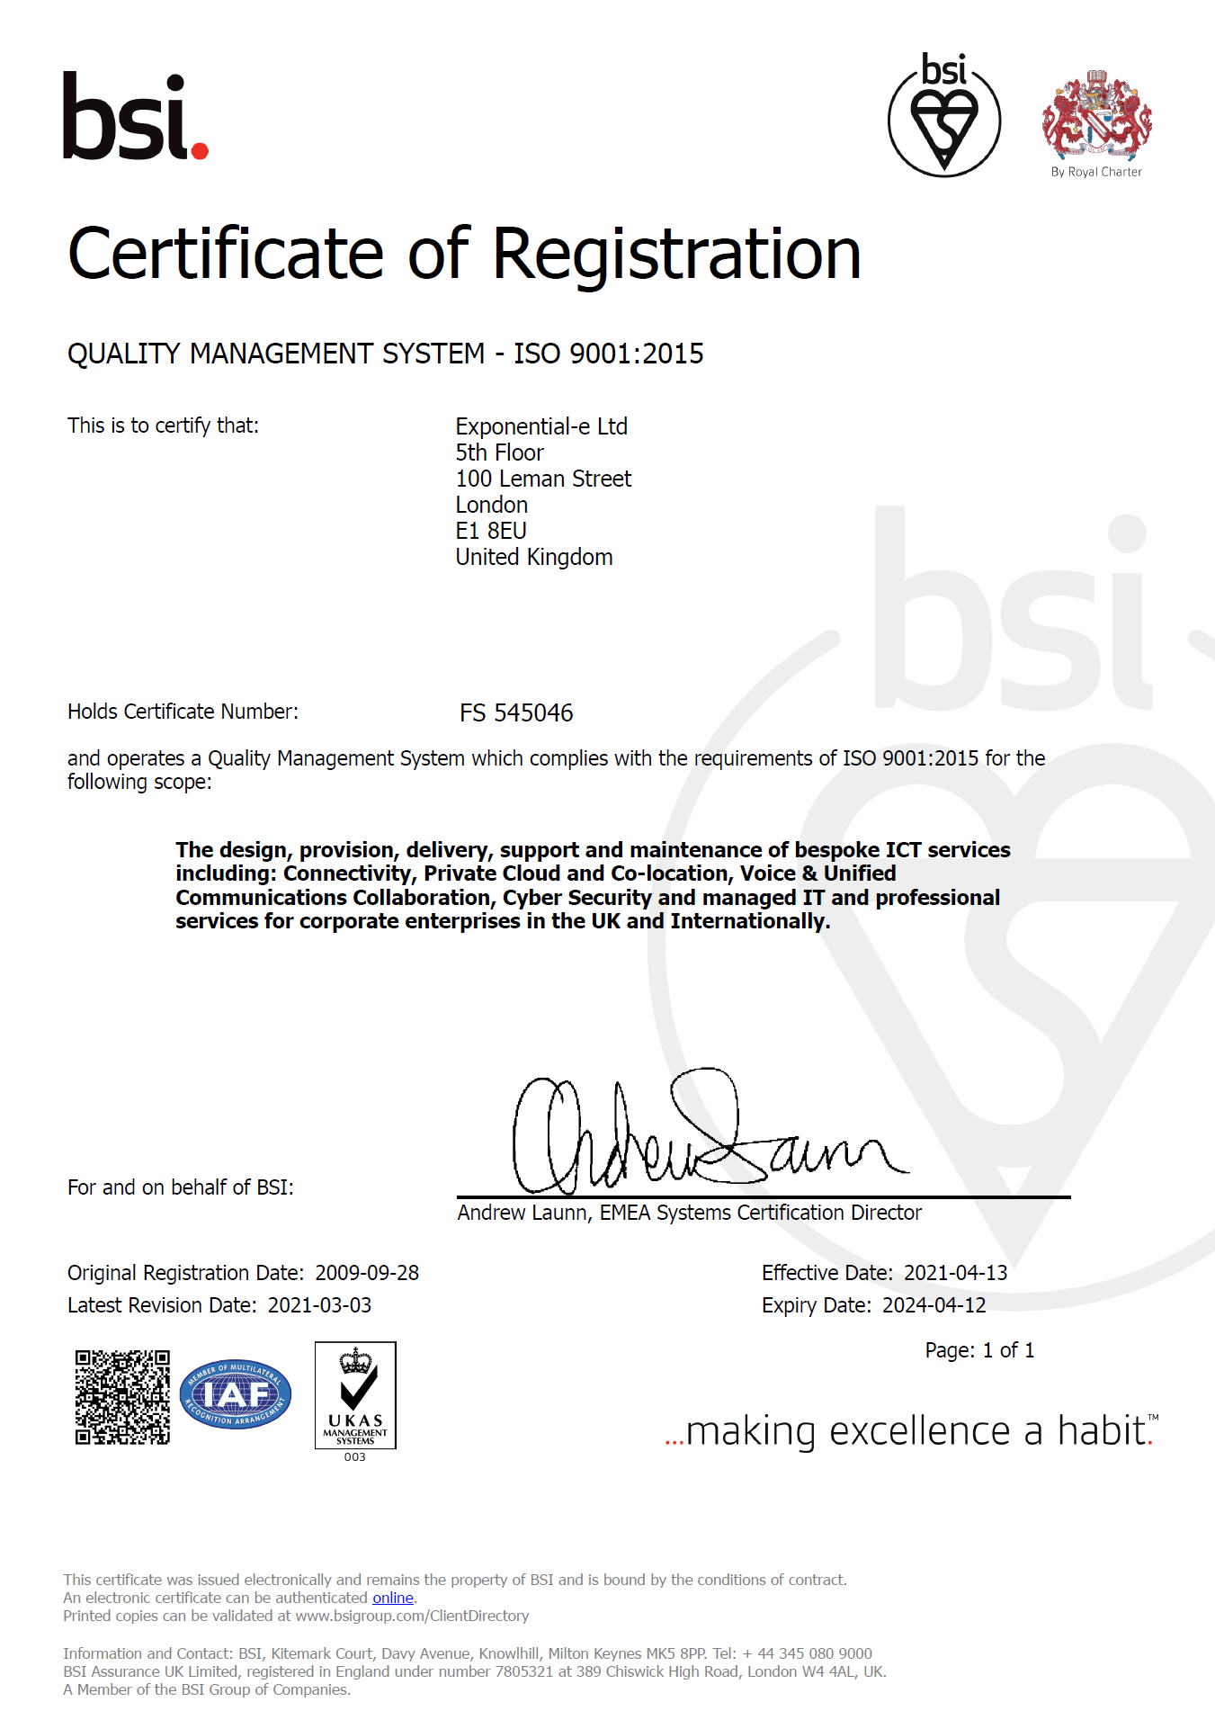
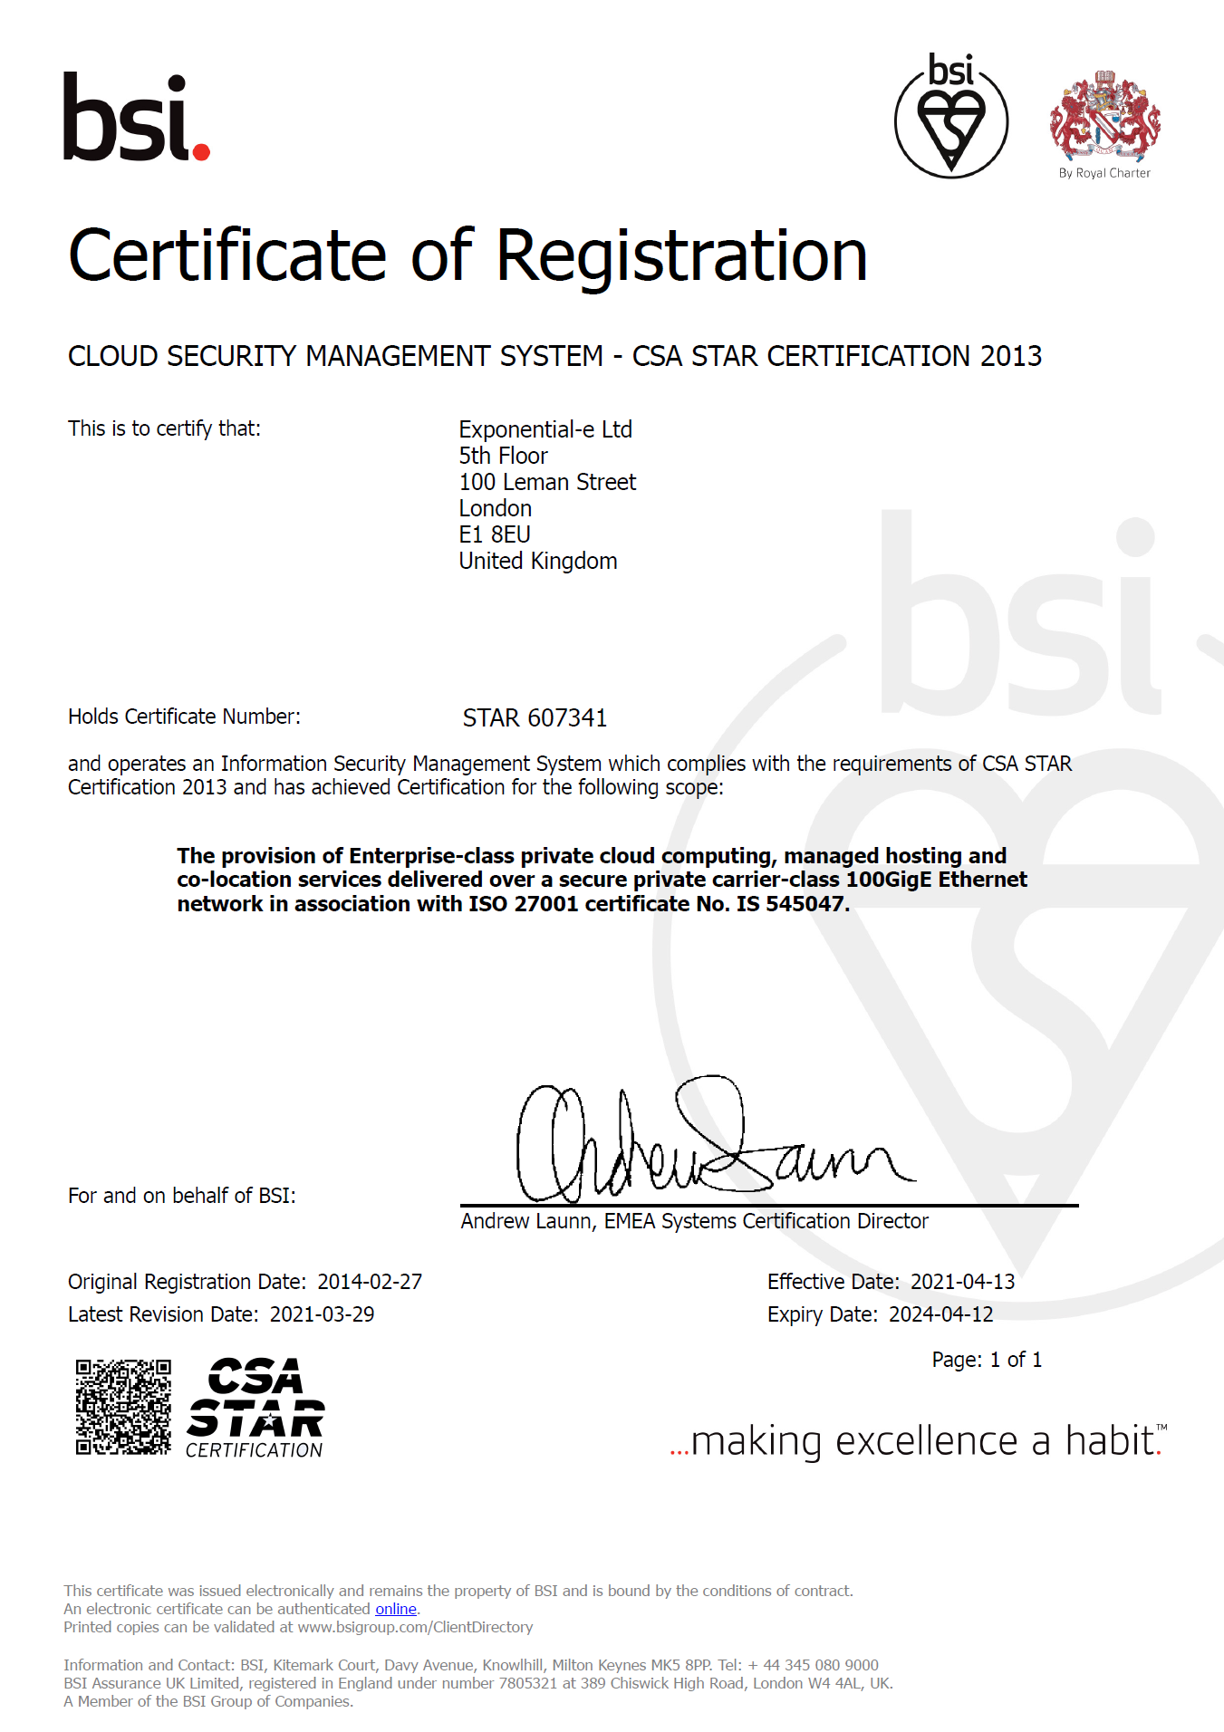
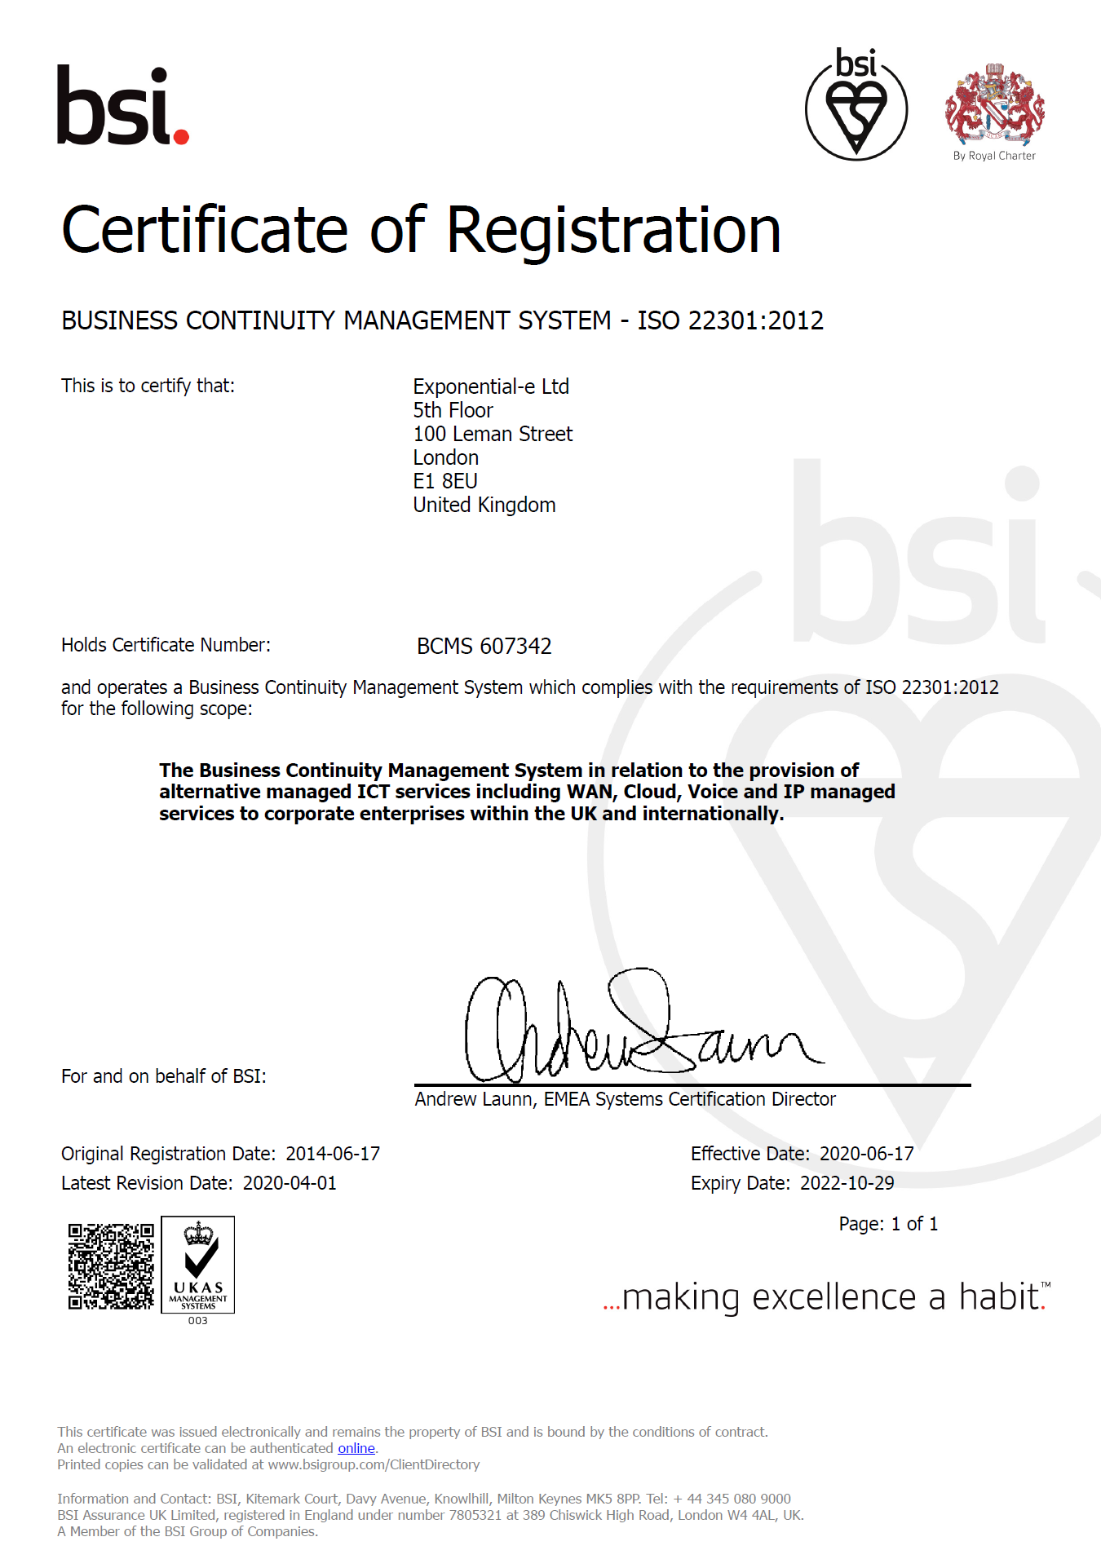
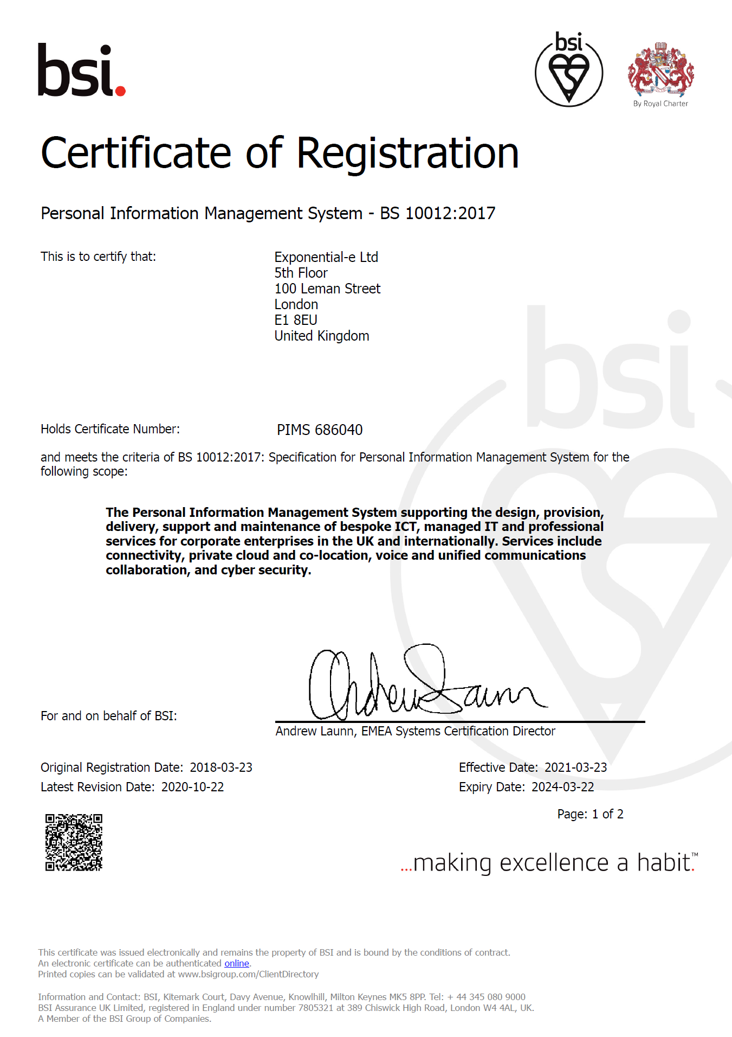
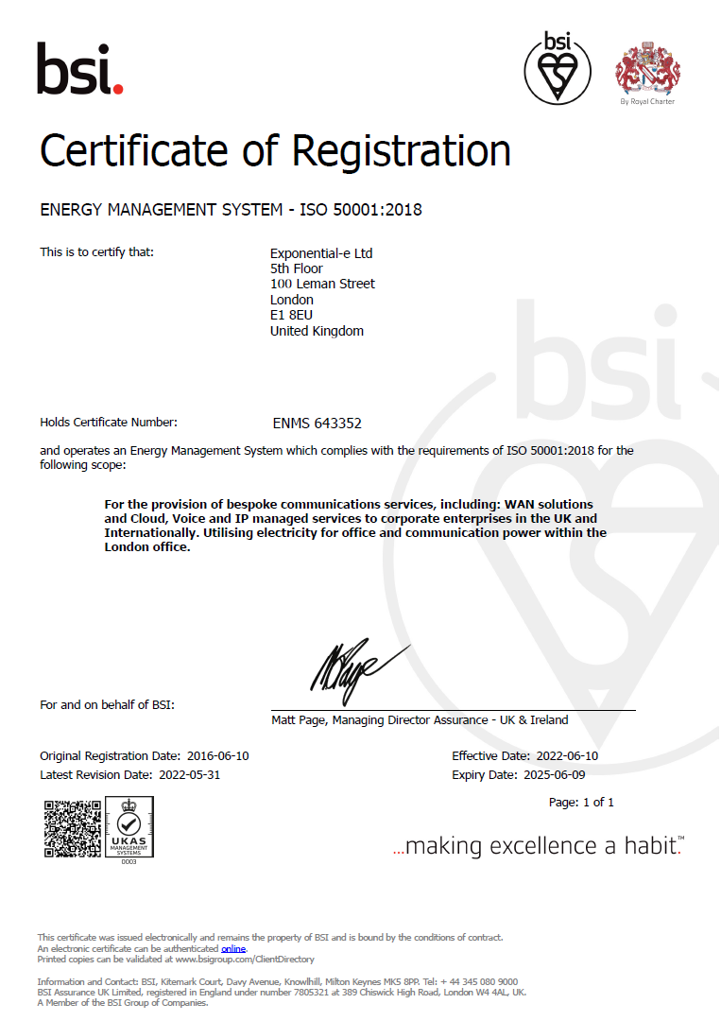
We are held accountable by our International Management Accreditations, procurement frameworks, clients & Staff
ISO9001
Quality Management
ISO27001
Information Security
CSA Star
Cloud Security
ISO22301
Business
Continuity
BS10012
Data Protection
ISO20000
IT Service
Management
ISO14001
Environmental
Management
ISO50001
Energy Management
ISO27017
Private Cloud Security
80
Approved Supplier: RM1043
Digital Specialists & Outcomes (DOS) v5
Approved Supplier: RM3764.3
Cyber Security Services 3 DPS
Approved Supplier: RM6116
Network Services 3
Approved Supplier: RM6100
Technology Services 3
Approved Supplier: RM6095
Gigabit Capable Connectivity DPS
Approved Supplier: RM6147
Technology Products Catalogue
Approved Supplier: RM3825
HSCN DPS
Approved Supplier: RM6094
SPARK DPS
Our Real-time ‘LIVE’ NET Promoter Score
Web Filtering, Monitoring & Reporting Services Framework

Slide 13
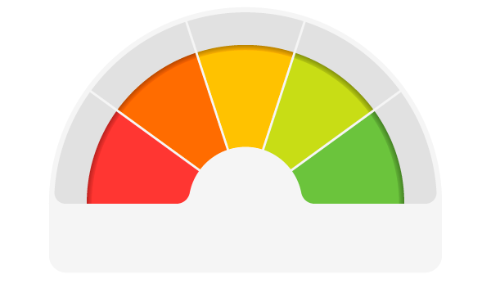
Support and Management - Voice of the Customer
Delivering Peace of Mind-as-a-Service
NPS is a loyalty and satisfaction metric developed in 2003
Every interaction with our Service Desk measured
Quick, simple feedback (5 seconds)
Fully integrated to our ServiceNow system so no need for a lengthy survey
Committed to calling back every customer that has provided Red or Amber feedback - most times within an hour
Live feedback system - shared across all teams, at all times
Live score on Exponential-e’s website - this updates every time feedback is received.
80
Knowledge (22%)
Collaboration (13%)
Speed (60%)
Advice (5%)
Not at all likely
Neutral
Extremely likely
0
1
2
3
4
5
6
7
8
9
10
Detractor
Passive
Promoter
%Promoters - %Detractors = NPS (Net Promoter Score)

Slide 14
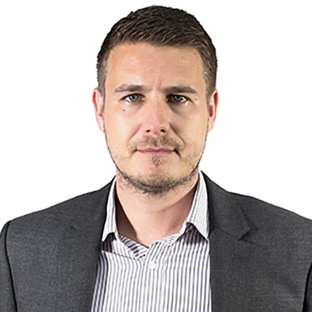
Delivery Within a Service Management Framework
Peer-to-peer relationships, and long-term partnerships
Continual Service Improvement Plan (CSIP)
Performance Reporting, Capacity Planning
Craig Bisley
Client Service Delivery Management Team
Your main point of contact for anything service related​
​
ITIL qualified​
Service Catalogue Management
End-to-End SLA Management
Governance Structure
Change Enablement

Slide 15
Mission & Vision
Be Unstoppable.

Slide 16
Mission
Our mission is to serve our channel community with unwavering dedication, providing them with margin-rich solutions complemented by world-class platinum-grade customer service

Slide 17
Our Channel Vision - EXPO.e
Dedicated Marketing Investment
Governance, Accreditation and Frameworks
Enable Channel
Be easy
to do business
Rebrand for new Channel identity
New brand
Look and feel
01
Working with new and existing vendors to increase MDF investment and improve engagement across the group.
20% increase for inbound lead-gen with more focus and resource on LinkedIn & AdWords PPC
Combine capability Driving unique solutions / margins
07
08
Discounts and Incentives
06
02
Reaffirming our commitment and focus
09
05
Targeting key regions with campaigns, events and memberships across the group,
Solutionize /
Money-makers
03
Always on nurture campaigns for our targeted verticals
04
2023 and Beyond
Strategic Collaboration – Public and Private Sectors
Partner Hub and Portal
Enablement team
Dedicated virtual team 100+ people
Platinum Service
Commitment to Net Promotor Score
Solutionize / Money-makers – Military Grade Solutions
Take advantage of 754 technical certificates / qualifications
Improving our brand awareness by increasing our PR, personalised content and LinkedIn Ads.
Increased Investment
Marketing and Sales
Updated high
quality content available to you

Slide 18
Our Culture
Our Goals
Be your trusted partner
Work together to strengthen collaboration
Get it right first time
Provide sustainable services that fit your future
Deliver best value for money
Connect
Collaboration
Transform
Our Values
To deliver outstanding value, partnerships and quality of care with transformative communication

Slide 19
Vision and Commitment
5. World-class Platinum Service for all partners
1. Strategic collaboration to achieve collective objectives
4. Resource-rich approach to become your trusted advisor delivering Peace of Mind as a Service
2. Enable channel with innovative solutions to simplify supply chain
3. Combine collective capability to maximise revenue and margin
Notes:
.

Slide 20
Strategy and Go to market
Utilise our Governance Accreditations, Certifications & Frameworks - Driving continuous improvement and open opportunity.
Revitalised Partner Hub Central place to find our pricing tools, marketing and training.
Every partner is Platinum World-class customer service, from first contact, throughout the life of the contract and beyond.
Easy to do Business with Ensure we are approachable, adaptable and accountable.
Customer Longevity Stickiness to support customer retention and displace competition with existing and new customers.
Reseller, Referral, Carrier Flexible models available to all partners.
Building sustainable Pipeline to exceed targets and build end to end solutions together.
Focused Approach Public / private sector, Regional / National, with dedicated support, marketing and enablement to work with you.
Deliver the highest conversion rates Provide “dedicated win” teams to support partners and win more business together.
Solutionize / Money-makers Together grow and maximise revenue and margin - Identify £100k FYR opportunities.

Slide 21
Let’s Solutionize™ Together
Be Unstoppable

Slide 22
Tech is being
Commoditised…
If we don’t solutionize™
we’re toast.
Be unstoppable. The Exponential-e Group Channel Partner Programme
www.expo-e.uk | 0203 993 3374

Slide 23
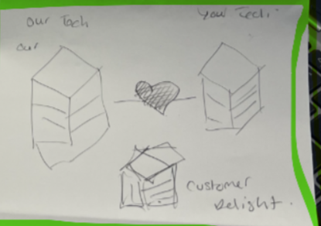
Inherently Secure - Full Stack
Our Technology
Customer’s Delight
Your Technology
Professional Services
Professional Services
Secure Telephone Systems
Support Services
Support Services
Secure Telephone Systems
CX Experience
AI/Automation
Multi-Cloud Platforms
Data Analytics
Network Platform
Desktop Agents
Fibre Infrastructure
CX Experience

Slide 24
Advantages of Solutionizing
Expand Market Reach
Competitive Differentiation
Customer Retention and Loyalty
Upselling and Cross-Selling Opportunities
Increased Value Proposition
Revenue/Margin Growth

Slide 25
Solutionized Partner Tool Kit
Strategy
Strategic collaboration, focused approach, vertical, public/private
Enable channel with innovative solutions to simplify supply chain
Combine collective capability to maximise revenue and margin. Flexible routes to market, resell/refer. Money maker focus, target larger opportunities
Resource-rich approach to become your trusted advisor delivering Peace of Mind as a Service. Achieving high conversion rates.
Sales & Marketing
Events, Workshops, Roundtable, Hospitality
Online Content, white label, datasheets
Email, presentation, blog templates
Account Management
Prospecting/pipeline growth
Solution specialist, Solution Overlay
Bid support, full or hybrid
Proposal templates/support
O&D team support
Solutionized Support
Working together
Demonstrate how to combine our technologies with yours - offering unique winning solution!
Sales
Discovery & qualification
Support call out day sessions
Commercial
How to increase margins
Building additional value and new revenue streams with your customers
Technical
Cornerstone specific
Solutions and overlay
Operation NOC and Support delivery
Enablement
Partner Hub engagement
Making it easy to do business with us
Delivering consistent enablement strategy &support building pipeline and margin growth
Agree critical success factors and report and tailor via regular meetings
Channelise product / solution materials
Channel partner training programme
MDF
Sponsorship
Service Management

Slide 26
Money-makers
S4 Cloud Storage
Disaster Recovery as a Service
Managed CSOC
Software Defined WAN & SASE
Unified Communications & Collaboration
ServiceNow
as a Service

Slide 27
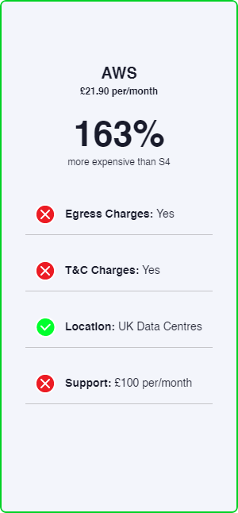
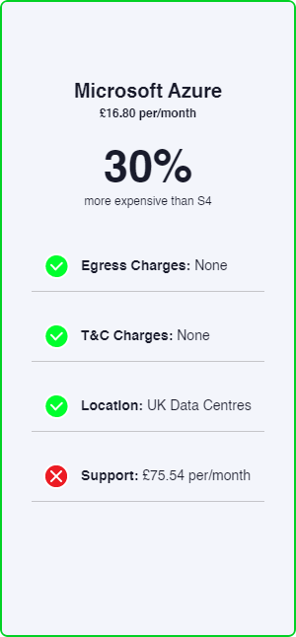
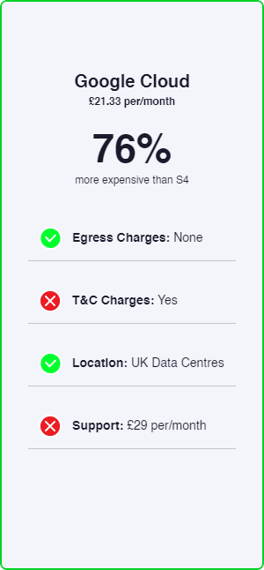
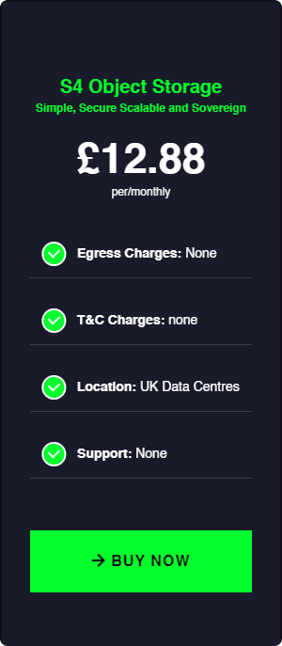
S4 Cloud Storage
Simple
Storage can be complex. S4 simplifies administration through single namespace management and universal accessibility.
Secure With data encrypted at-rest and in transit, S4 gives complete security, plus all the cost-efficiency and scalability benefits of multitenancy storage.
Scalable
Hardware-agnostic, Cloud enhanced scalability lets customers grow raw capacity while sustaining high-performance, on any infrastructure.
Sovereign
With S4, customers don’t have to worry about data sovereignty: data will never leave our UK-based, privately-owned Network and Data Centres.

Slide 28
Disaster Recovery as-a-Service
EXPO.e's DRaaS model encompasses offsite backup and replication for both physical and virtual systems, combining Zerto’s leading-edge software-defined replication & recovery automation technology with our self-owned, enterprise-class network - delivered as a fully managed service
Stress-free Restoration Process
Critical systems restored in seconds, via Predictable Recovery Point Objectives (RPO) and one-click failover.
Disruption-free Deployments
No downtime required during the installation of the Zerto Virtual Manager and replication engine.
Full Control & Visibility A highly intuitive online portal provides the customer with fully centralized management of their DR process.
Guaranteed Data Integrity Near-zero data loss should DR protocols need to be initiated, with automatic failover.
A Comprehensive Service Wrap
Additional capabilities around data centre moves, application migration and hybrid Cloud projects open the door to numerous add-on services.
Effortless Integration
A hardware, storage and application agnostic, providing customers with the freedom to integrate Zerto with their existing systems.
A Fully Managed Service
EXPO.e’s certified Cloud specialists provide hands-on guidance to streamline and optimize the disaster recovery process.
Everyone’s Our Platinum Partner 24 / 7 support from EXPO.e’s UK-based Service Desk.

Slide 29
Managed CSOC
EXPO.e’s Managed CSOC allows your customers to take a proactive approach to cyber security while minimising the resulting burden on their own IT teams.
EXPO.e’s fully certified cyber security experts work to identify any potential breaches and ensure the appropriate actions are taken. There are numerous elements to this, including:
Real-time Cyber Security Monitoring
Operating 24 / 7 x 365 to proactively identify any potential threats and issue automatic alerts - all based on the very latest threat intelligence.
The Unified Security Management (USM) Anywhere Platform
Manage the entire security ecosystem through a fully centralized, highly intuitive platform.
An Advanced Persistent Database
Fully integrated with the security ecosystem, a comprehensive breakdown of the latest threats, updated by the end users.
Automated Categorization of Devices and Assets Streamline compliance with corporate cyber security policies.

Slide 30
SD-WAN & SASE
EXPO.e’s connectivity portfolio brings together a comprehensive range of leading-edge solutions, designed, delivered, and managed by leading experts, supported by robust SLAs, and built on our self-owned, enterprise-class network.
The result is optimal control and scalability, reduced operational costs, and an accelerated path to the Cloud, with the highest standard of cyber security inherent in the design of every solution.
An industry-leading SD-WAN solution
Drawing on EXPO.e’s years of experience as a UK pioneer in software-defined connectivity - delivered as a fully managed service.
Secure Access Service Edge (SASE)
Combining leading-edge networking and zero-trust cyber security in a Cloud-based solution, to provide optimal control, protection, and visibility.
Managed LAN and WiFi
Intelligent connectivity and a centralised, highly intuitive user interface, for maximum control and visibility.
24 / 7 Support
Proactive support from EXPO.e’s own UK-based NOC.

Slide 31
Unified Communications & Contact Centre
In partnership with EXPO.e, you can facilitate flexible, remote working practices for your customers, increasing their recruitment options and driving creative collaboration.
This, in turn, will offer insights that help build deeper customer relationships and open the door to integrating AI and machine-learning into their business operations.
Quality Voice & Video
High-quality voice and video calls, powered by our resilient core Network, eliminating the effects of jitter, latency and packet-loss.
Credible Comms
Offer your customers peace of mind, with our optimally secure, fully PCI-DSS compliance platform, which boasts industry-leading 9 ISO accreditations.
Platinum Service Quality
Proactively managed voice services and support, with end-to-end SLA and exceptional service quality.
UCC Dedicated Portal
EXPO.e make it easy for you to do business with us and manage your customers through our automated self-service UCC Portal.

Slide 32
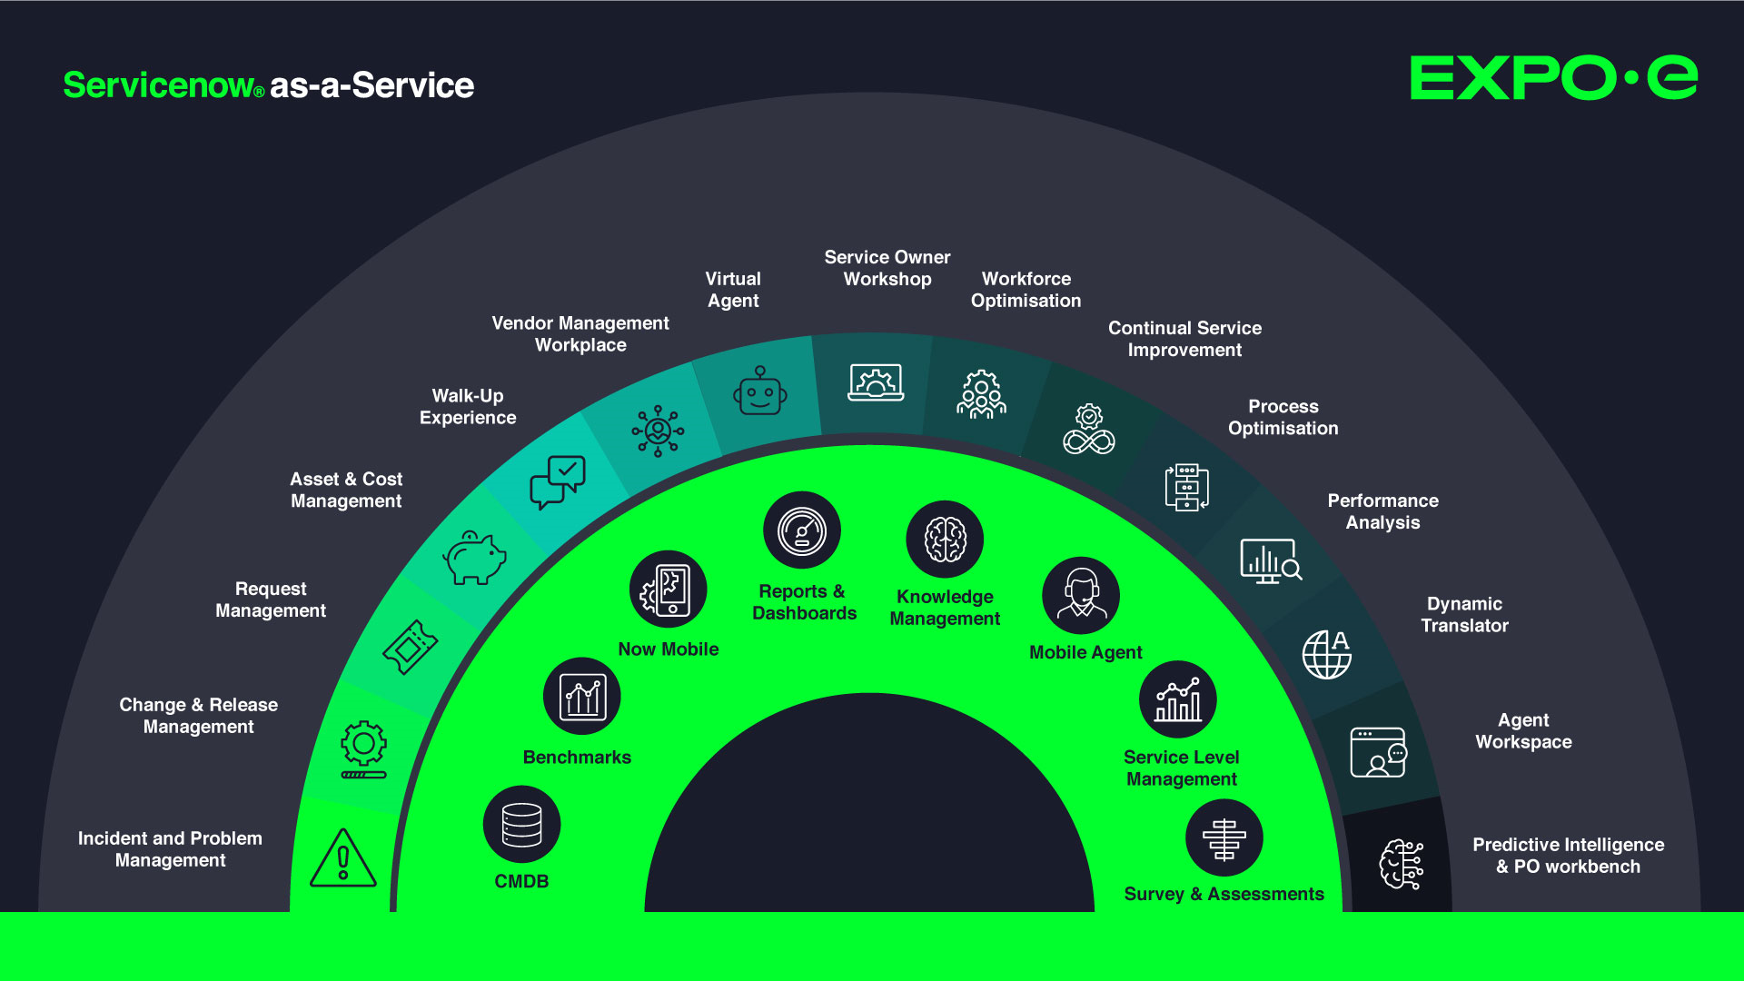
Simple sales messages

Slide 33
Our Capabilities & Wider Portfolio
Be Unstoppable

Slide 34
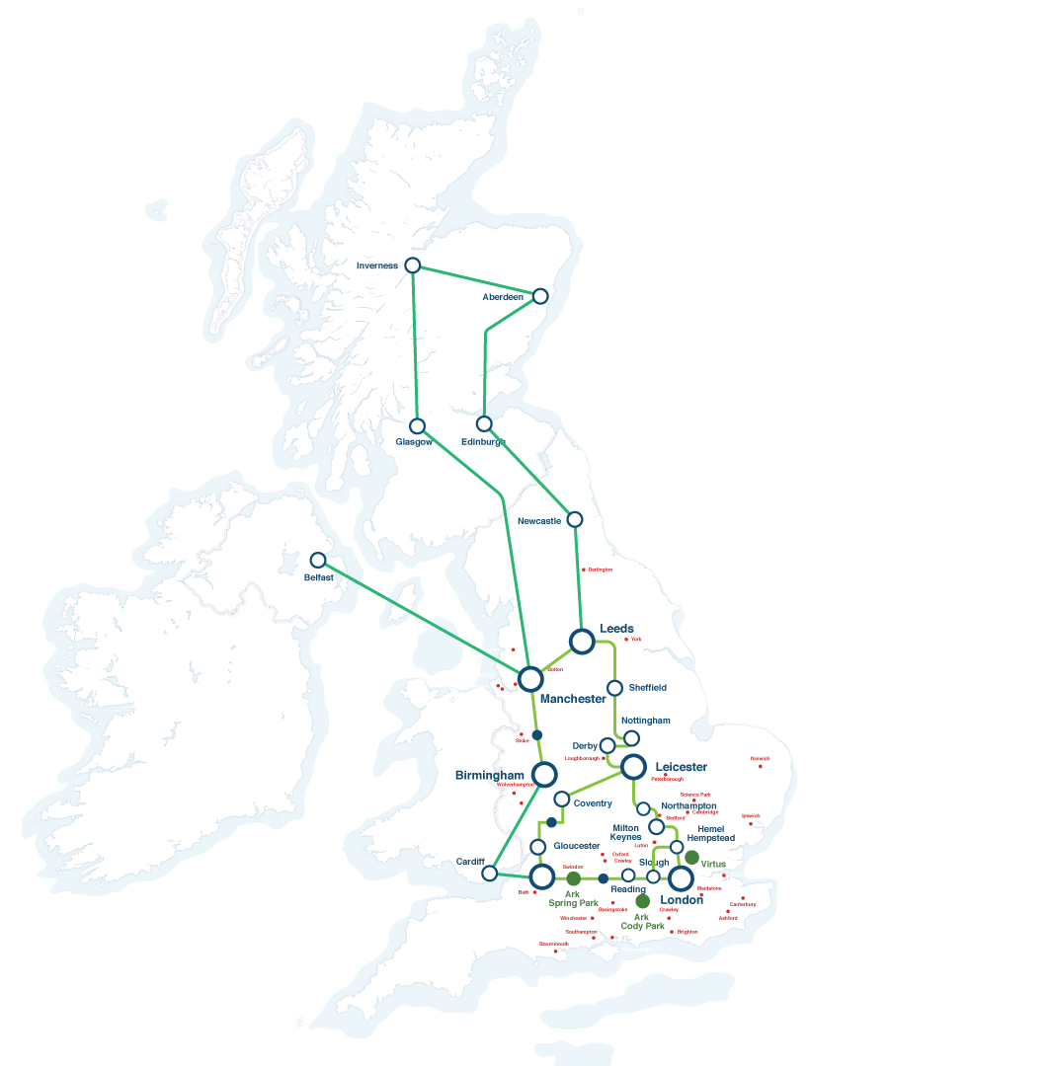
EXPO.e £120m Infrastructure Investment
International Reach
Fully owned and managed high capacity, next generation Cloud, UC / Teams / Collaboration and Security network.
Geographically resilient data centres
Multiple tier 1 carrier interconnects delivered across diverse private fibre
Carrier grade, market leading unified communications platform, providing collaboration and SIP trunk services, delivered across multiple DCs
Microsoft Teams Direct routing platforms, delivered across multiple DCs
Contact Centre as a Service (CCaaS)
Carrier Grade SBC infrastructure, protecting our UCaaS / CCaaS platforms
International PSTN carrier services
Self-service customer provisioning portals
Proactive fraud management and monitoring
Auto fraud detection and blocking
170
177
6
Towns & Cities
Local Exchanges
Internet Gateways
39
212
2000+
Data Centres
PoP’s
Kilometre Fibre
6
300+
200K
Connect
to US East Coast
UK City Metros
Internet Peers
OnNet Postcode
180+
NNI
Connect
to US East Coast
Connect to Amsterdam & Frankfurt
Connect to Paris

Slide 35
Our Capabilities
End User Engagement
Cloud Management Platform
Software-Defined Tech
Multi-Cloud Capability
Digital Transformation Team
Cyber Security
EXPO.e CAPABILITIES
Unified Comms & Contact Centre
Network Reach
Migration Skills / Tools
Professional Services
Managed IT Services
Managing Legacy Systems

Slide 36
Our portfolio is your portfolio
Connectivity
Global reach with: VPLS
MPLS
SD-WAN and SD Data Centre
Ethernet
Broadband
LAN & Wi-Fi
4G / 5G LTE
Internet
Full inter-connectivity to public clouds (Amazon, Azure, Google)
Cloud
Shared and dedicated private cloud
Public Cloud - Azure CSP
Hyper-converged infrastructure (VX Rail)
Cloud Management
Ultra low-cost Object Store
Storage-as-a-Service Citrix DaaS – Hybrid Apps and Desktops
GPU for render & HPC
Cloud Network Peering (AWS, Azure, Google)
Unified Communications
UCaaS powered by Cisco Webex
Teams Calling as a Service
Contact Centre as a Service
Collaboration as a Service
Contact Centre for Microsoft Teams
Hosted telephony
SIP trunking
Business Continuity and Disaster Recovery
Continuous Server Replication
Secure Backup - Shared & Dedicated
Data archiving & Long-Term Retention
M365 Backup
CyberVault (air gapped immutable backup)
Professional services
Cloud Adoption and Migration - Azure, Hybrid & Dedicated
Server & Application Migration
EUD Refresh & Rollouts
M365 Consolidation and Migration - Zero Trust
Data Consultancy, Cloud Readiness, Automation
Managed Services
Service Desk
SIAM and Service Now Deployments
Infrastructure Management
O/S Management windows / Linux / VMWare / Hyper-V / 0365
Patching/ Backup / Monitoring Services
EUC - PCaaS, White Glove Imaging & Deploy
Security
MFA
PAM
Endpoint Protection and Security
End-to-end encryption
Single-sign-on portal management
SIEM
Perimeter Firewalls
CSOC
Managed DDOS and Ransomware Protection
Threat Monitoring and Intelligence
Vulnerability Remediation

Slide 37
Our Technology Capabilities
Unified Communications
Cyber Security
Network, SD-WAN, LAN & Wi-Fi
Cloud & Prof. Services

Slide 38
Why EXPO.e
Customer Service Quality
Customer served 1st philosophy since 2003
Service culture begins in Academy
3,000 customers - 96% Reference-ability
Real-time ‘live’ Net Promoter Score = 80. Consistently scoring high on an Index ranging from -100 to 100.
Voice of the customer - Continuous improvements program
Board level escalation
Applied Innovation
Levering technology for the benefits of the customer
First movers in Ethernet (2002) & VPLS (2006)
World-first with APM (2010) 100GigE VPLS Network (2012)
Innovative approach keeps clients at leading edge
Cyber Security Operations Centre and Cloud Management Platform
Multi Vendor Global SD-WAN service
Technical Capabilities
100 GigE business only Network
Reputation built on the delivery of high performance Networks
212+ PoP’s reaching into 39 Data Centres
Multiple services delivered securely at Layer 2
Built and manage our own Cloud, Voice-UCC and Cyber Security Platforms
Trusted Partner
9 x BSI / ISO standards, as well as the highly coveted Cloud Security Alliance STAR
UK Service Desk offering 24 / 7 Fault, Find and Fix Pro-active 1st, 2nd & 3rd line support
Carrier-class Network for resilience / reliability
Financial stability - D&B 1 Credit rating
2022/2023 £206m and EBITDA £81m (Group)
Peace of Mind as a Service - NPS 80

Slide 39
Success Stories
Be Unstoppable

Slide 40
Our Partners

Slide 41
Success Stories
Having the right supplier is just as important as listening to customers. We like people that are honest, responsive and proactive, EXPO.e exceed across all of these areas.
William Linard Head of Sales, Luminet
Notes:
https://youtu.be/Xn9YYrbOF7A

Slide 42
Success Stories
The most important thing at the outset of any new partnership is establishing trust between teams. Once you've built a strong rapport and are working towards shared goals, the technological innovations follow naturally.
Terry Faria Telecommunications Manager, Quiss Technology.
Notes:
https://youtu.be/NKlNLnhvheA

Slide 43
Success Stories
It's the shared values that have really been the foundation of our relationship with EXPO.e, as well as their willingness to do things a bit differently.
Robb Thaw Marketing Manager, Natilik.
Notes:
https://youtu.be/SVy3oGHl_d0

Slide 44
Onboarding Checklist
TASK | Completed
NDA Signed | ü
Channel Deck presented to C-Level / Sales Managers & Sales Team
MRA / MPRA signed
Set frequency of meetings with Partner Sales Teams
Set up access to Partner Hub
Ensure access to all portals - CPL / UC / SNOW / LogicMonitor
Enablement session arranged / Material for all portals to be shared
Introductory incentives

Slide 45
Partner Enablement Hub
Be Unstoppable

Slide 46
What is EXPO.e Enablement and how will it benefit you
Make it easy for your Account Managers to work with us
Partner Hub
Consistent strategy aligned with your objectives
01
09
02
Training requirements and delivery
Help you grow pipeline and margins
08
03
07
04
Understand if there are areas where you won’t need our support
Focus on Money-makers, UC & ServiceNow as a Service
06
05
Focus on finding the gaps where we can support
Support with joined up marketing approach

Slide 47
Training and Onboarding
Training
Sales
Discovery & qualification
Run call out day sessions
Commercial
How to increase margins with EXPO.e solutions
Building additional value and new revenue streams with your customers
Technical
Cornerstone specific
Solutions and overlay
Operation NOC and Support delivery
Onboarding
Tailored strategy for your business
Structured plan to meet your growth objectives
Focus on new margin rich revenue streams
Enablement planning
Devise bespoke training program
Maximise the Partner Hub
Our Toolbox is your Toolbox - Find the gaps for growth
Our resources are your resources - maximise our resources for you
How to engage

Slide 48
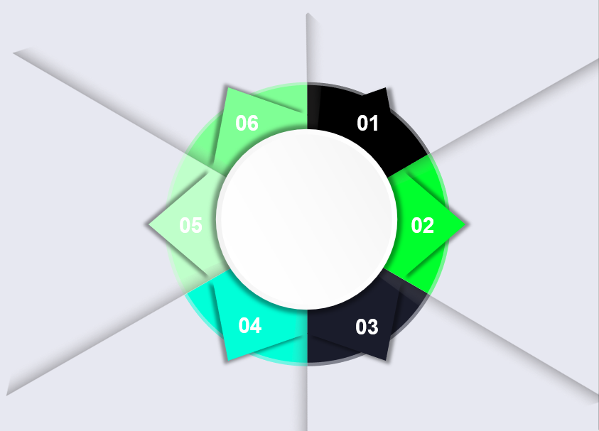
Success Factors
Agree and track defined approach to drive success
Regular pipeline and closed business
Success
Consistent onsite visits and engagement with all Account Managers
Success Factors
Find the gaps - focus on Money-makers and quick wins
Identify, create and evolve plan for training requirements for team
Partner Hub engagement

Slide 49
Partner Hub - Partner Registration
Notes:
https://www.youtube.com/watch?v=j6SaMfR7G_I

Slide 50
Partner Hub Live Demo

